Slide 1

The Title
Wen Liu
Jiaqi Liu
Zhiyuan Liu
Chen Zou

Slide 2
Overview
Background and Background
Data
DEA Model and Linear regression model
Analysis and Conclusion
Further Consideration
1
2
3
4
5

Slide 3


Motivation and Background
Two topics are often referred to when people (no matter they are basketball lover, NBA player and team manager) talk about NBA: 1. Who will win national championship this session? 2. Are player payed fairly?
Also interested in such topics, we decided to pick out the most competitive team in the league and try to compare a player’s performance with his annual salary. The first one gives us a chance to predict who will be the champion and the second one shows us which player is seriously undervalued.
This is a good time point for us to do prediction because the trade window has closed, players list won’t change.

Slide 4
Data
NBA Official Website – Stats
FGA | Field Goals Attempted | DREB | Defensive Rebounds
FG% | Field Goal Percentage | AST | Assists
3PA | 3 Point Field Goals Attempted | STL | Steals
3P% | 3 Point Field Goal Percentage | BLK | Blocks
FTA | Free Throws Attempted | PTS | Points
FT% | Free Throw Percentage | TOV | Turnovers
OREB | Offensive Rebounds | BLKA | Blocked Field Goal Attempts
PIE – Player Impact Estimate

Slide 5
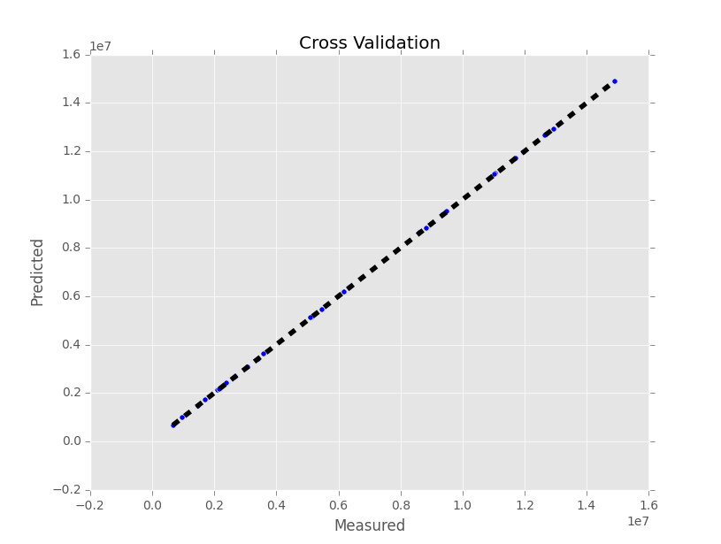
Linear Regression
Linear regression is a simple but effective way to fit data.
We divide continuous PIE value into small ‘bins’ and fit it with average salary of players who are projected to particular bin.
Cross validation has proved that linear regression is suitable for this situation.

Slide 6
DEA Model
DMUs:
30 NBA Teams -- EAST League (15), West League (15), All Conferences(30)
Efficiency:
ratio of catgory2/catgory1
DEA Model:
find out the best practice DMUs.
Super-efficiency Model:
rank the best practice DMUs.

Slide 7
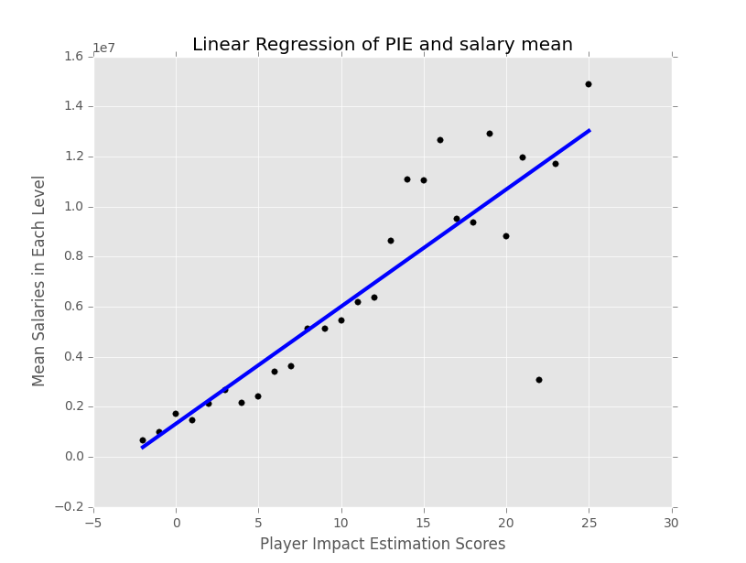
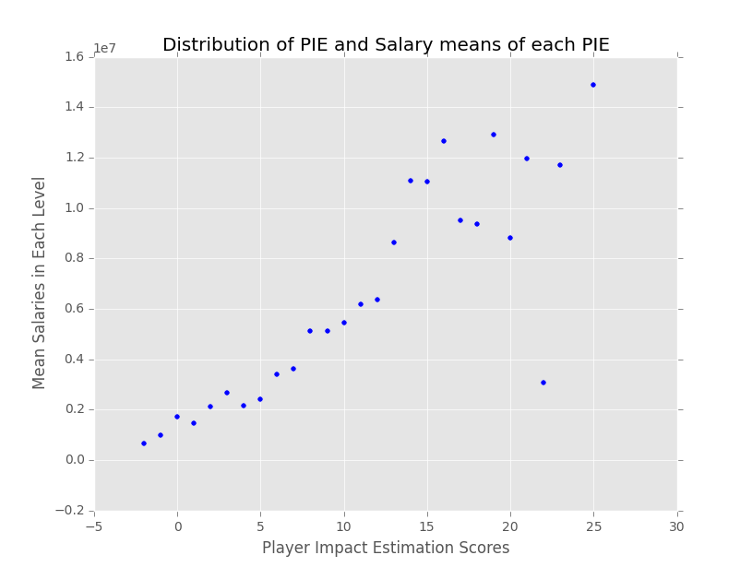
Result – Player Salaries
A fine linear model is fitted and players scatter below the line much are believed to be undervalued.
This simple but convincing model give reference to team’s managers about who to hire.

Slide 8



Result – Top 3
1.419
1.087
WIN ≠ BEST
1.023
All scores are super efficiency scores

Slide 9
Analysis - West
Team | DEA Score | Super Efficiency DEA Score | Rank
Los Angeles Clippers | 1 | 1.419 | 1
New Orleans Pelicans | 1 | 1.023 | 2
Golden State Warriors | 1 | 1.015 | 3
Portland Trail Blazers | 1 | 1.011 | 4
Memphis Grizzlies | 1 | 1.008 | 5

Slide 10
Result - East
Team | DEA Score | Super Efficiency DEA Score | Rank
Charlotte Hornets | 1 | 1.087 | 1
Toronto Raptors | 1 | 1.015 | 2
Atlanta Hawks | 1 | 1.002 | 3
Boston Celtics | 0.941 | 0.941 | 4
Chicago Bulls | 0.930 | 0.931 | 5

Slide 11


Further Consideration
Data Science in Material Science
The Movie Moneyball tells a story about how data science
digged valuable pattern that ignored by empirical and
traditional views.
Material Scientists still rely heavily on their experience
while trying to invent new material. ( Or they inherit
theory from physics.) With proper pattern recognition
methods, researchers would push their research to a
new edge.

Slide 12
Further Consideration
Data Science in Material Science
Fundation
Materials, including elements in periodic table and billions of organic components, have their own character.
Besides this, pairs of materials with particular characters will usually produce same kind of chemical reactions with proper conditions. (And this is also an empirical saying.)
Although tools like computational material science exists, the current situation is that researchers still rely heavily on try-and-error method, which is notoriously inefficient.

Slide 13
Further Consideration
Data Science in Material Science
Possible ways to boost
Establish databases which contain physical and chemical characters of some fundamental material. For instances, lattice constants for crystals, weight-average molecular weight for high polymers.
Computers memorize more and compute faster. They can be used to find potential componets which combine different advatages of each compositions.
Some research centers may conduct hundreds of large-scale experiments per quarter and produce gigabytes of data waiting to be analyzed. Even naïve methods in machine learning and pattern recognition will help.

Slide 14
Further Consideration
Data Science in Material Science
Possible negative arguments
Exceptions always exists and are more than rare. This brings difficulties in pattern recognition.
Some experiments do not produce enough data to perform learning methods.
But…
Exceptions render us opportunities to dicover new theories.
Most experiments are scalable.

Slide 15
THANK YOU!

